Slide 1
Tolly’s Tech Teachings
Session 1
Active Directory

Slide 2
Ground rules
This is the start of a small series of support sessions set up to help you guys with your Systems Security assignments.
As such, there are a few clarifications and ground rules that need to be acknowledged:
These sessions are NOT designed to hand answers out for the assignment
These sessions have been set up in my free time, with independently verified resources used.
Do not waste what little time is left for the module, and do not waste other people’s time.
Do not blatantly rip off the material in these presentations as your own work – this not only harms yourself, but everyone else using these resources! Collusion and plagiarism are a bitch, and it can obliterate your prospects at University!
Notes:
These sessions are NOT designed to hand out answers for the assignment to you, as doing so would put everyone in this room at risk of plagiarism
These support sessions have been set up in my free time. Please do not disrespect the time we have available or the sessions that have been set up.

Slide 3
Active Directory – A brief overview
Active Directory is a Directory service made for Windows Domains.
I’m pretty sure most of you know what this means and the capabilities, but to summarise:
It runs on Windows Server installations – turning them into Domain Controllers (DCs)
It provides multiple services for connected machines, including:
Authentication and Authorization of users and computers in a network (including privileges)
Assigning and enforcing policies for connected computers
Managing installed software and providing endpoints for capable software
Active Directory uses LDAP 2 & 3, DNS and Microsoft’s version of Kerberos

Slide 4
Active Directory – Hierarchies
Active Directory’s internal management heavily relies on hierarchies
Users & Computers
Group Policy Management
Internal system structuring & role assignment
Active Directory allows an administrator to create their own hierarchies using Organisational Units (OUs)
Anything applied higher up in the hierarchy is applied to everything below
Notes:
PLEASE USE THESE! They are extremely helpful when splitting up user groups, making it look tidy and keeping stuff separate
It also helps with your group policy assignments, which will be explained now

Slide 5
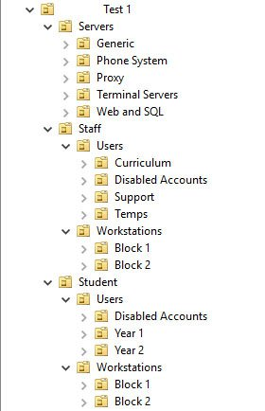
Active Directory – Hierarchies
Note that in this example, each major folder is split up into sections.
This includes servers, users and workstations.
For this example, everything inside the red box will be referenced
If a policy or setting is applied to the top folder in this section, it will filter out to the rest of the units in the red box
If a policy is applied to the top folder in the inner blue box, everything below this folder will be referenced
Notes:
Hierarchies lay out the foundations on how policies and settings “trickle down” to lower users.
This allows for broad policies to be specified quickly and efficiently, whilst still providing granular control over individual groups and users if required.

Slide 6
Active Directory – Hierarchies
Notes:
Here is what the previous example looks like in a hierarchical view. The root domain is where you apply global policies, with finer control provided for entries nested further in the tree. An example of this would be for

Slide 7
Active Directory – User management
Active Directory has its own User management system
Used for providing information about users to programs
Used for listing user-specific information
Used to assign permissions to each user – e.g. Domain Admins, Local Admins, Hyper-V Managers, DNS managers etc.
Easily accessed from the Start Menu or Server Manager

Slide 8
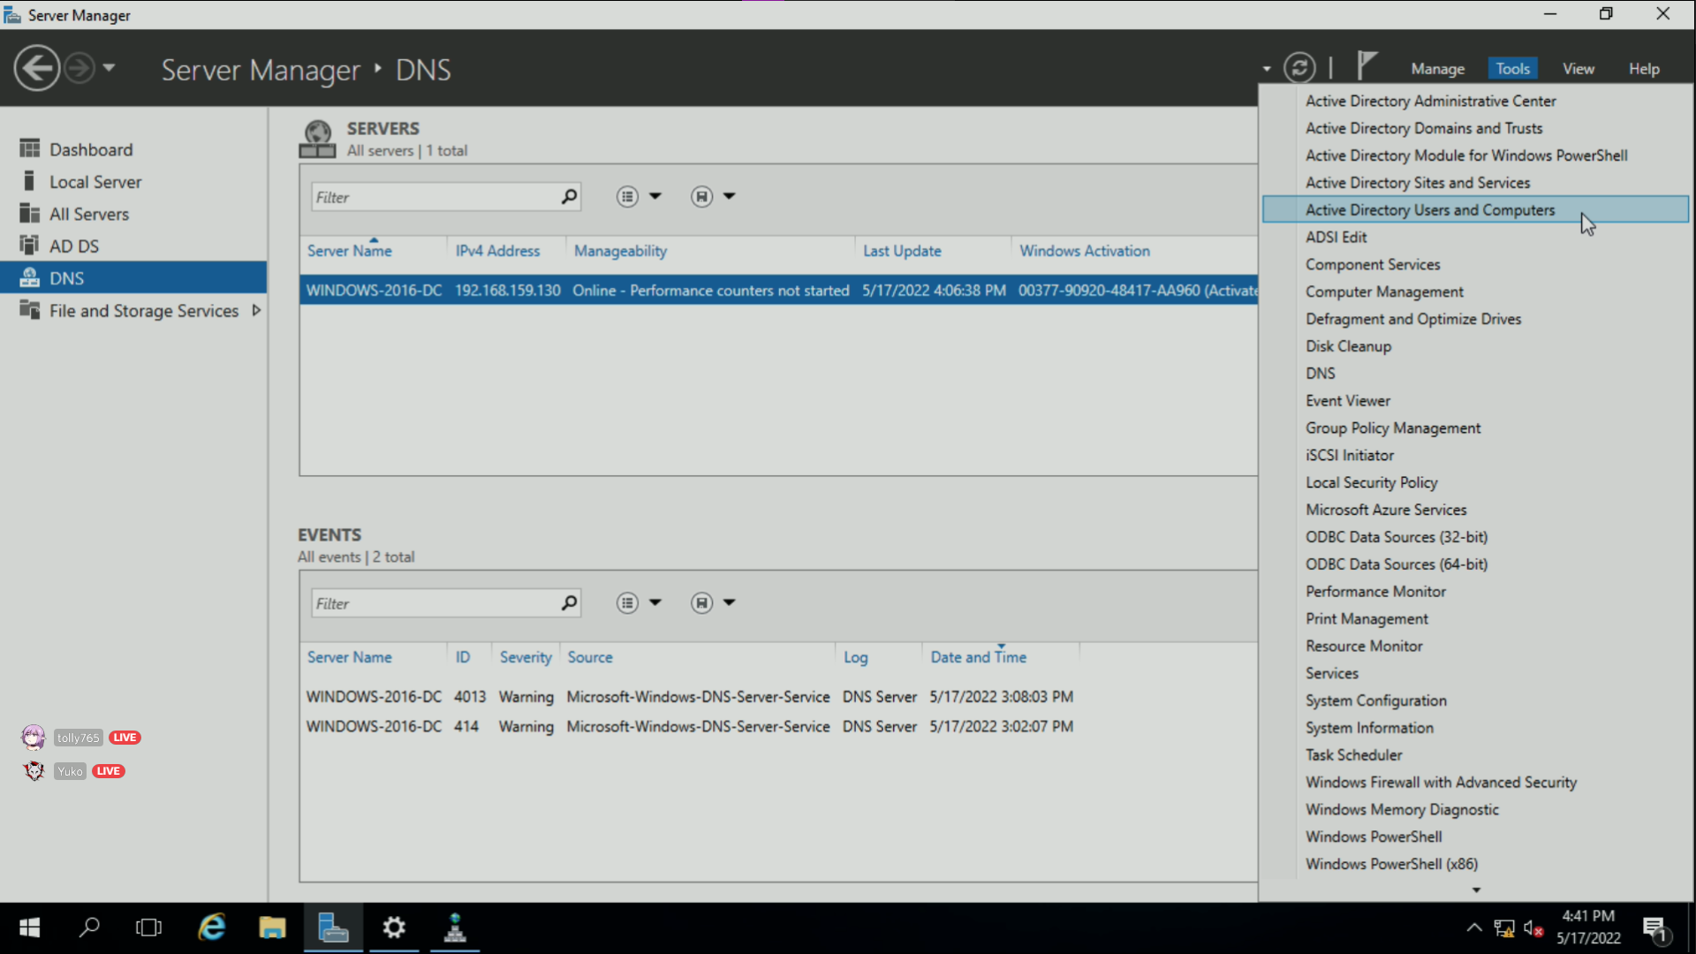

Slide 9
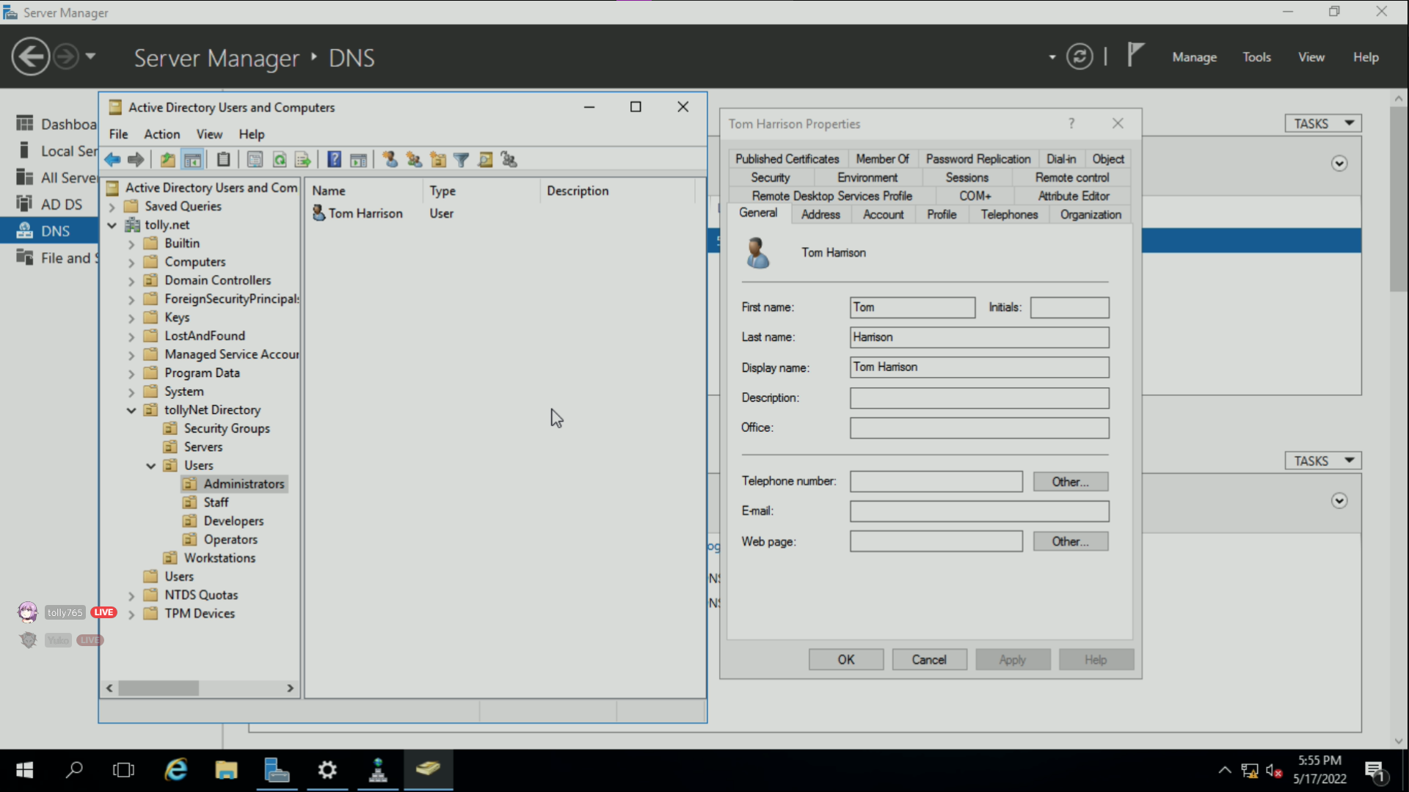

Slide 10
Active Directory – User management
Active Directory’s user management console provides a lot of options to the administrator.
DON’T PANIC! It is a lot simpler than you may think.
This is accessible when double clicking a user or right clicking and selecting Properties in Users & Computers
For standard users, they can only modify their own data. Administrators can modify this information for all users.
Everything regarding users is managed in this interface – make sure you remember it!

Slide 11
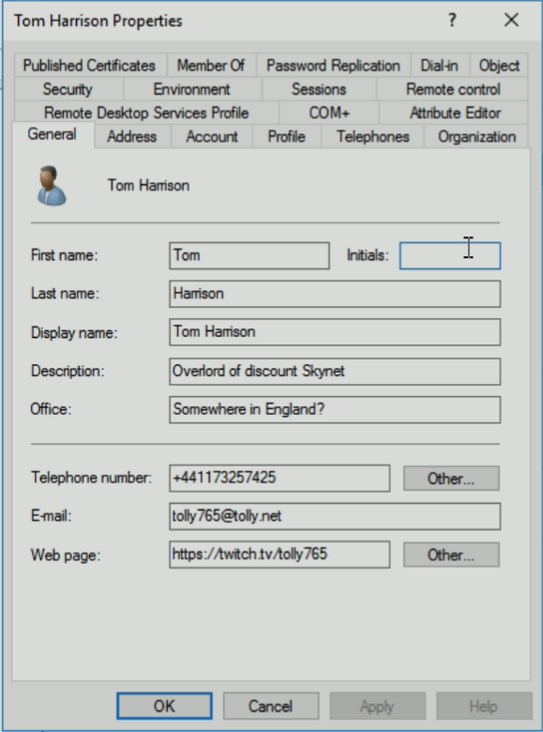
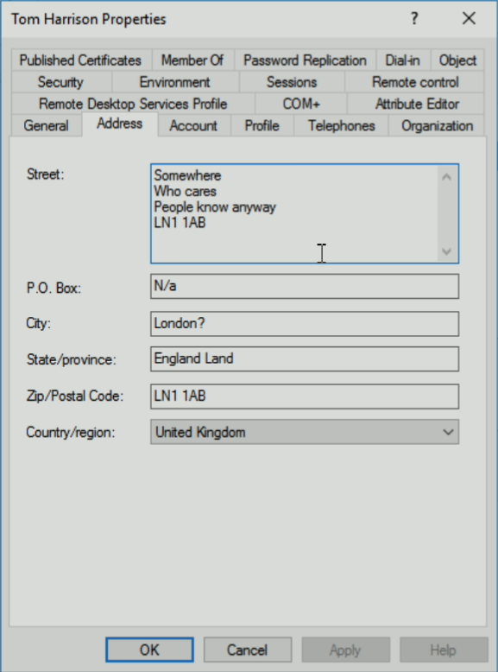
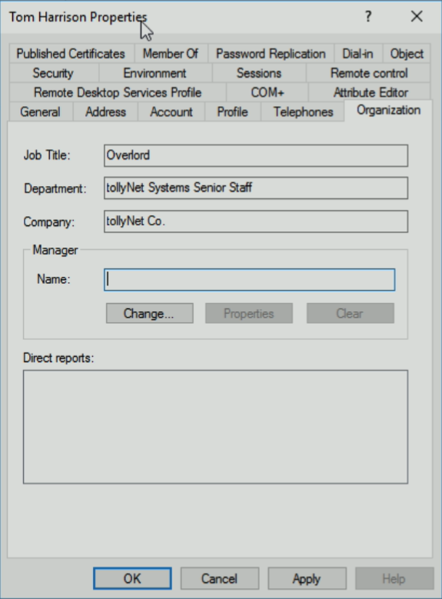
Active Directory – User Properties

Slide 12
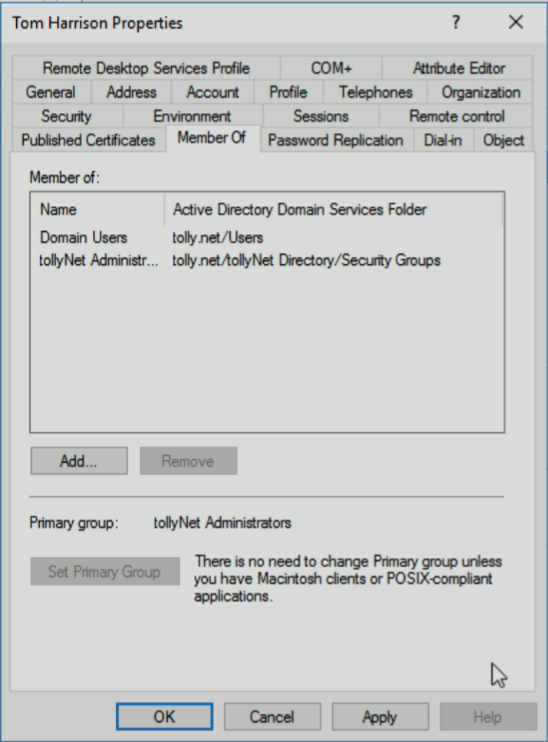
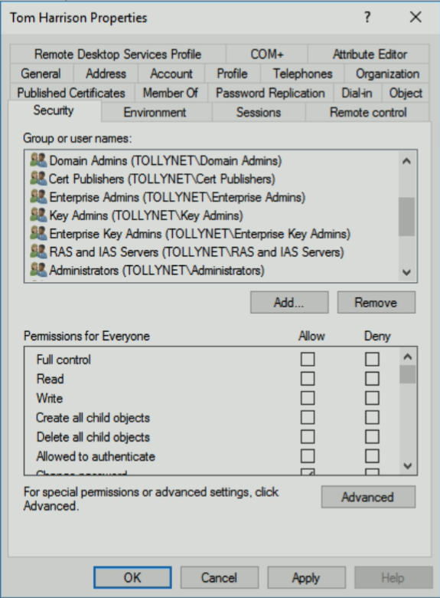
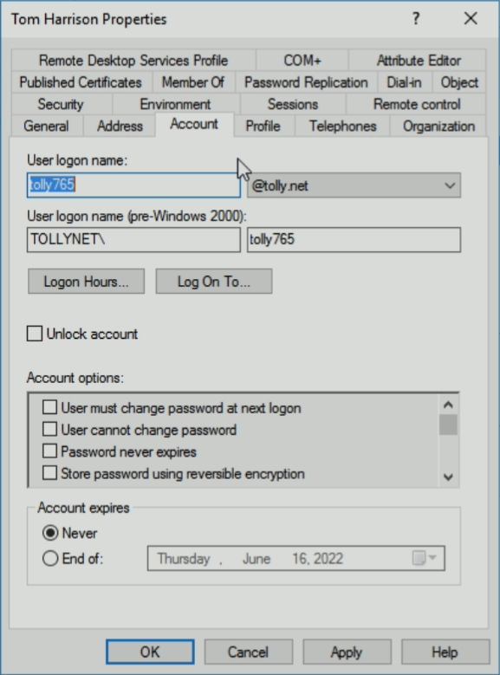
Active Directory – User Properties

Slide 13
Active Directory – User management
Active Directory’s user management console provides a lot of options to the administrator.
DON’T PANIC! It is a lot simpler than you may think.
This is accessible when double clicking a user or right clicking and selecting Properties in Users & Computers
For standard users, they can only modify their own data. Administrators can modify this information for all users.
Everything regarding users is managed in this interface – make sure you remember it!

Slide 14
Active Directory – Group Policy
Group policy controls the working environment of user and computer accounts
It is VERY powerful, and can be applied to both Windows and Linux* clients
Group Policy can be finnicky at times – be patient with it!
There are an extremely large amount of policies available – Google is your friend!
* Linux clients require additional config – see https://access.redhat.com/documentation/en-us/red_hat_enterprise_linux/7/html/windows_integration_guide/sssd-ad
Notes:
Group Policy is the de-facto way of managing clients through Active Directory. Group Policy works natively with any Windows version newer than Windows 2000, with new policies introduced over time.
It is extremely powerful, but it comes at the cost of complexity and very awkward management at times.
Linux clients can be configured to use Group Policy through Active Directory – see the redhat link for details.

Slide 15
Active Directory – Group Policy
For 95% of the policies available, it is good practise to create a GPO specific to the task needing to be performed
There are exceptions to this, such as references to user & password lockout policies
This is very simple to do, and can be scaled up as needed
Again, Google is your friend!

Slide 16
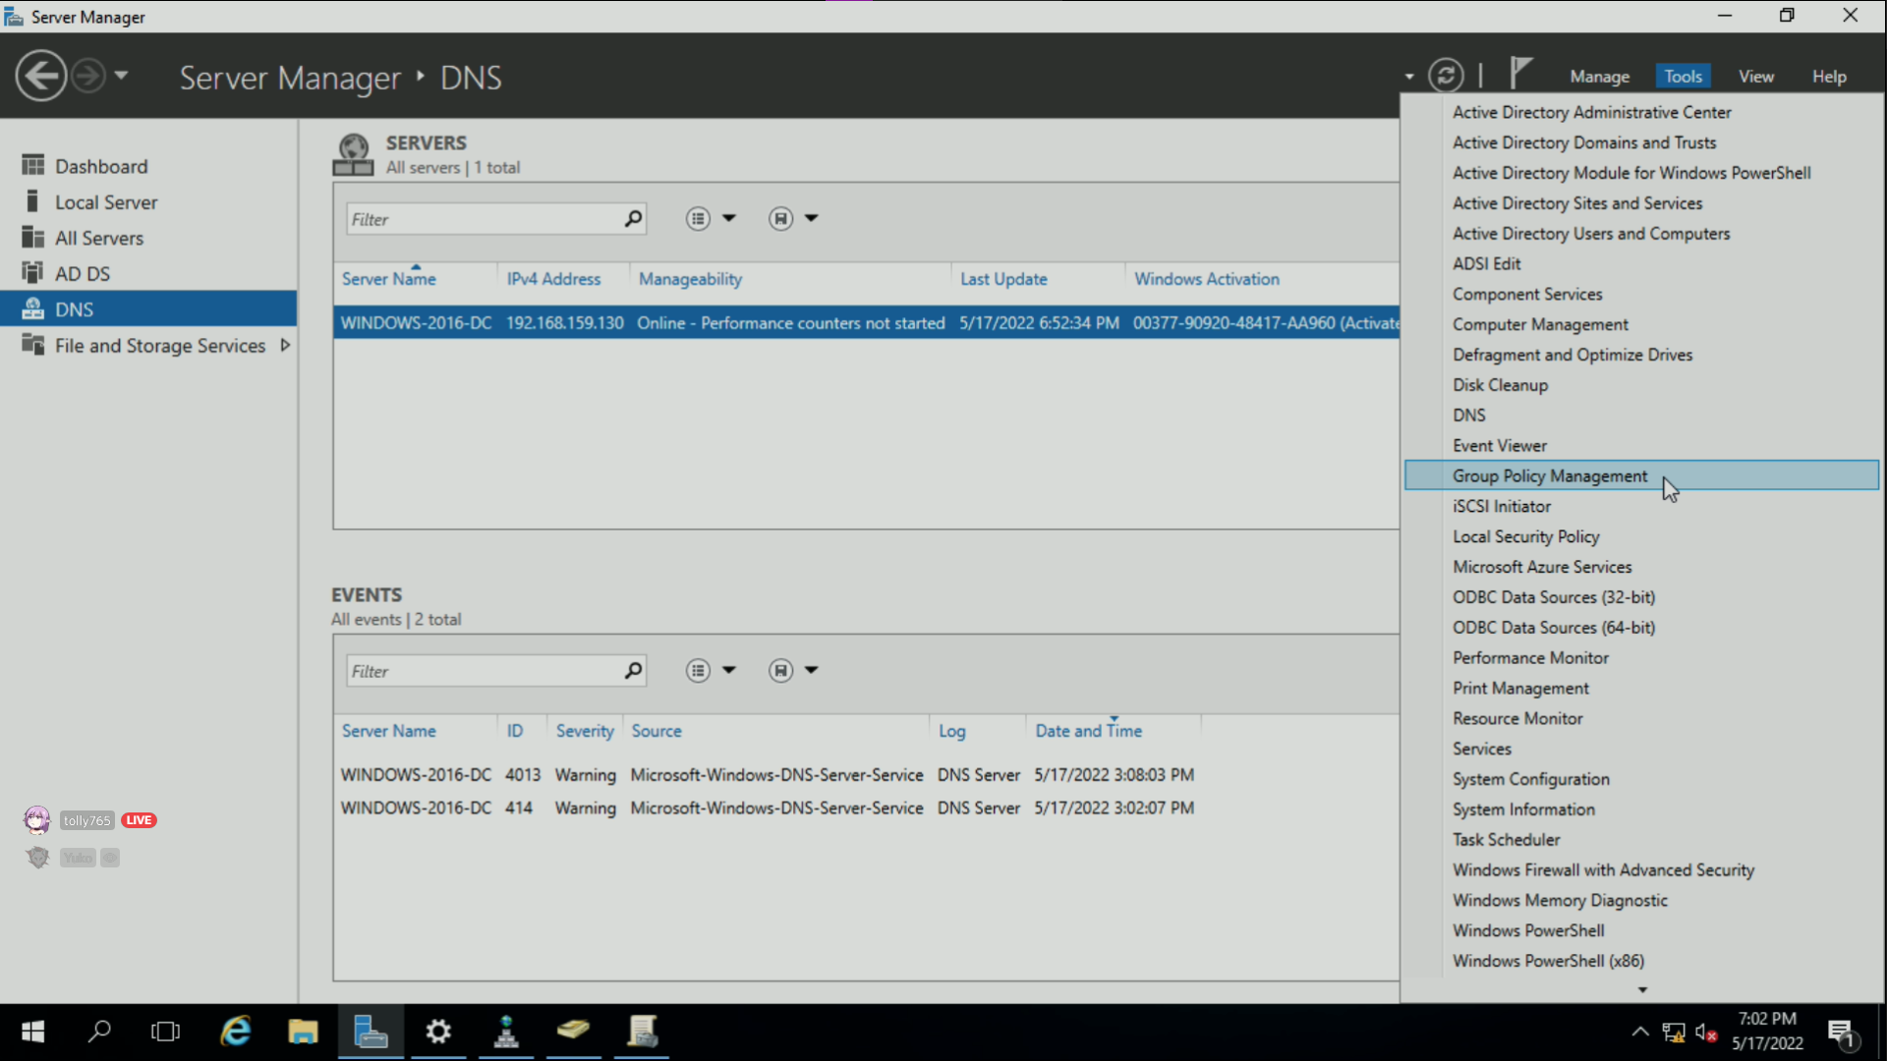

Slide 17
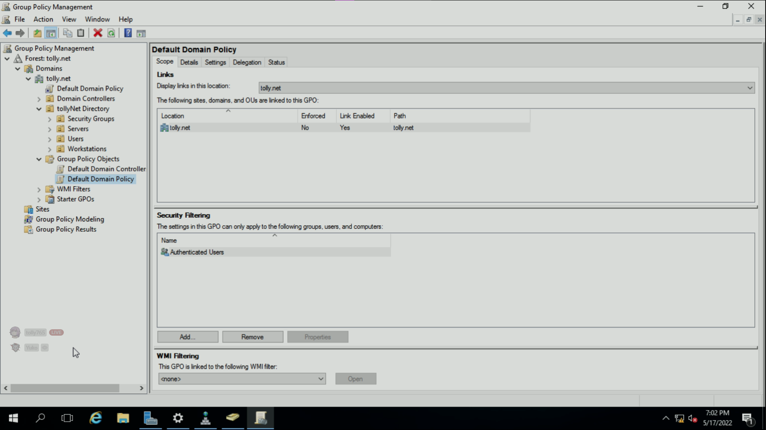

Slide 18
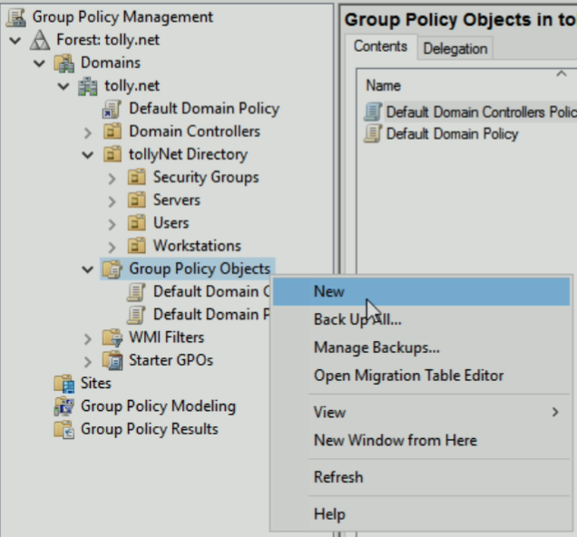
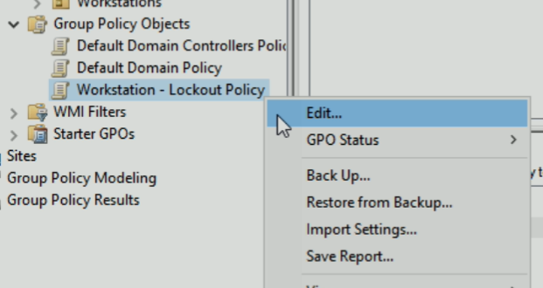
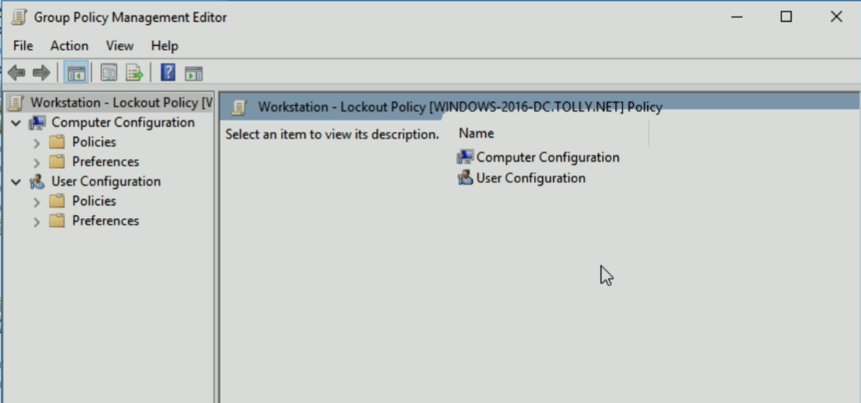
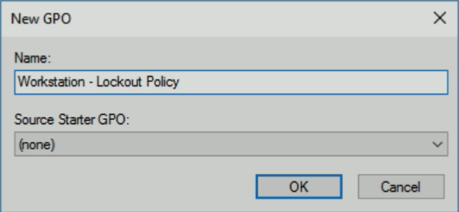

Slide 19
Active Directory – Group Policy
A significant portion of the project brief will be done through Group Policy
Make sure you know how to navigate it, how to check settings and how to apply settings
Settings are applied through Scope options, or by dragging a policy to the required OU

Slide 20
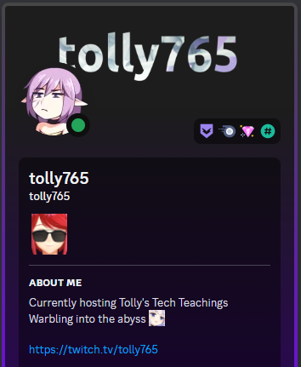
Work time?
If there are any questions, feel free to ask. More sessions are coming, so answers may be given there.

