Slide 1
Tolly’s Tech Teachings
Session 2
Authentication

Slide 2
Ground rules
This is the start of a small series of support sessions set up to help you guys with your Systems Security assignments.
As such, there are a few clarifications and ground rules that need to be acknowledged:
These sessions are NOT designed to hand answers out for the assignment
These sessions have been set up in my free time, with independently verified resources used.
Do not waste what little time is left for the module, and do not waste other people’s time.
Do not blatantly rip off the material in these presentations as your own work – this not only harms yourself, but everyone else using these resources! Collusion and plagiarism are a bitch, and it can obliterate your prospects at University!
Notes:
These sessions are NOT designed to hand out answers for the assignment to you, as doing so would put everyone in this room at risk of plagiarism
These support sessions have been set up in my free time. Please do not disrespect the time we have available or the sessions that have been set up.

Slide 3
Authentication – What is it?
Authentication is the process in which you (the client) are proving you are who you are to somebody else (the server)
This is done using passwords, certificates, email verification, PINs and more
It is used for pretty much everything that is based on a network – computers are always doing it.

Slide 4
Authentication – Networking
At this point, it is assumed that your Windows and Linux VMs are joined onto the domain you previously made
If this has not been done yet, PLEASE DO THIS! It is essential to the module
This covers about 50% of the network authentication needed for the module, as this allows Windows users to seamlessly authenticate itself and allows your Linux VMs to log in through the command line.

Slide 5
Authentication - Networking
This can be tested on the Linux VMs by using the su command
su admin1@c1234567.com
su staff1@c1234567.com
su dev1@c1234567.com

Slide 6
Authentication - Linux
You may have spotted a few issues with this setup though…
Sudo access?
Home Directory Creation?
GUI logins?
FTP access?
These are all fixable, but very finnicky to do

Slide 7
Authentication - Sudo Access
Sudo is a utility for Linux that allows users to run commands and programs as root – without needing the root password
It is a very powerful utility and needs to be locked away – only usable by certain people
We’re using Active Directory, but Sudo is a local tool
How to fix?

Slide 8
Authentication – Sudo access
Sudo access is managed by /etc/sudoers and the /etc/sudoers.d folders
Access can be granted to specific users, linux groups and… AD groups!
Unfortunately, the syntax for this is… precise. It can be very awkward to get the correct syntax and it depends on how the machine was set up.

Slide 9
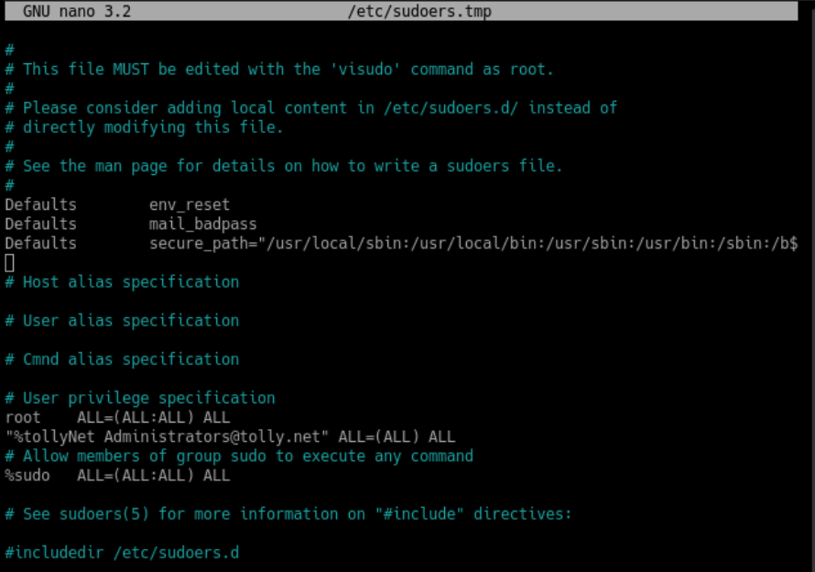
Authentication – Sudo access

Slide 10
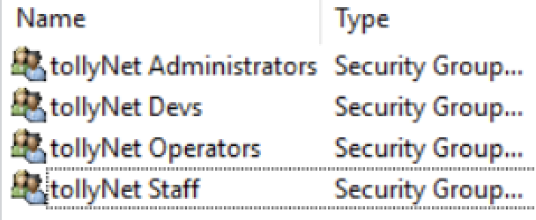
Authentication – Sudo access
On your Windows 2016 DC, find the admin group and note down the exact name of the group you want to give sudo access
On the Linux computer, log in with the local user (or root account if you have that set up)
Type in the following command:
sudo vi /etc/sudoers
Scroll down to the section marked as “User Privilege Specification”
Add a new line under here with the following syntax:
“%Group Name Here@c1234567.com” ALL=(ALL) ALL
Make sure to replace the C number and Group names with your own!

Slide 11
Authentication – Home Directories
By default, Linux clients will create a home directory for local accounts when they log in.
This does not apply to Domain accounts by default…
How to fix?
PAM!

Slide 12
Authentication – The Eldritch Horrors of PAM
PAM stands for “Pluggable Authentication Modules”
They are used for authorization, authentication and password changing on the system
They are also used to define additional actions when user sessions are started
This is accessible by editing the pam-configs folder/files, or by using the following command:
sudo pam-auth-update
Sources: https://unix.stackexchange.com/questions/131195/home-directories-and-pam-d-using-ldap - http://www.linux-pam.org/Linux-PAM-html/sag-pam_mkhomedir.html - https://askubuntu.com/questions/1010302/enable-pam-module-as-default

Slide 13
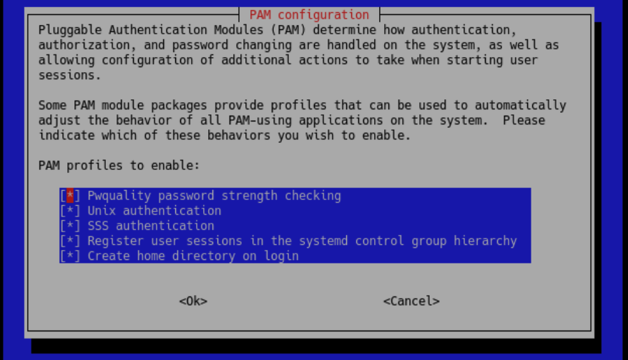
Authentication – The Eldritch Horrors of PAM
sudo pam-auth-update

Slide 14
Authentication – The Eldritch Horrors of PAM
sudo pam-auth-update

Slide 15
Authentication – The Eldritch Horrors of PAM
It is recommended that you restart sssd when you modify PAM files
sudo systemctl restart sssd
Sources: https://unix.stackexchange.com/questions/131195/home-directories-and-pam-d-using-ldap - http://www.linux-pam.org/Linux-PAM-html/sag-pam_mkhomedir.html - https://askubuntu.com/questions/1010302/enable-pam-module-as-default

Slide 16
Authentication – GUI Logins
GUI logins are a bit trickier, as the standard login manager in Debian does not support logging in on a domain account
To remedy this, you will need to install a new session manager.
For this example, we will use LightDM – A login manager that looks fairly nice and supports logging in with a username and password
This can get confusing and is quite long-winded. Take your time with this!

Slide 17
Authentication – GUI Logins
MAKE NOTE OF YOUR LOCAL USERNAME!!
You will not be able to log in if you forget this!
Turn on the proxy for Linux if you have not done this yet
Execute the following command:
sudo apt-get install lightdm
Accept the installation and wait for it to finish
Execute the following command:
sudo dpkg-reconfigure lightdm
Sources: https://wiki.debian.org/LightDM - https://linuxhint.com/change-display-manager-debian-linux/

Slide 19
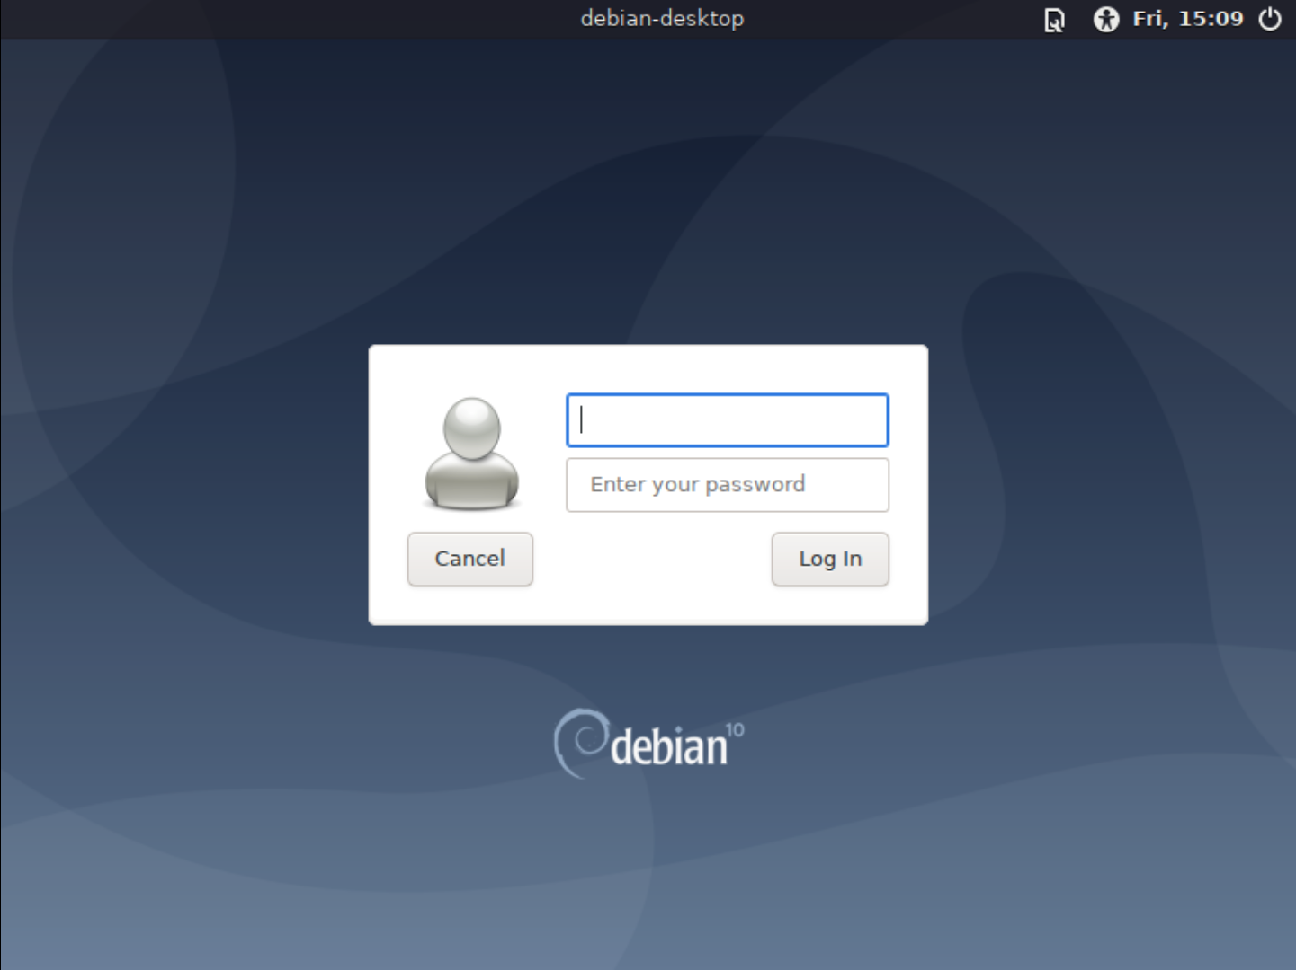
Authentication – GUI Logins
You should now be able to restart the VM and the new login manager will appear.
Logins should now be done using your domain username and password
admin1@c1234567.com

Slide 20
Authentication – GUI Logins
Sometimes, your domain logins may not work correctly. It may accept your login, go black for a second and then return to the login screen, it may crash and restart your system.
The most common reason why this happens is because a home directory does not exist for the user.
To remedy this, log in as the root user with sudo su
Go to the /home folder cd /home
Create a folder in here for the new user mkdir new_username

Slide 21
Authentication – GUI Logins
Type in the following command:
sudo mkdir UserNameHere@c1234567.com
Make a note of the user’s group from the 2016 DC
Type in the following command:
sudo chown UserNameHere@c1234567.com:”Group Name Here@c1234567.com”
Restart the VM and try to log in to the domain account again.
Make sure to replace the C number, Group name and Usernames with your own!

Slide 22
Time for a short break!
The next section will cover Windows-based authentication. Make sure to take a snapshot of your Linux setups once this is complete!

Slide 23
Authentication – Windows Admins
So far, we have covered how to provide sudo level access to domain accounts on Linux
We have yet to cover Windows Administrative Access
How do we go about this one?
Group Policy! (If you’re not using Samba DC or OpenLDAP – these slides do not cover these setups unfortunately)

Slide 24
Authentication – Windows Admins
Group policy (as mentioned previously in TTT 1) is used to control the working environment of User & Computer accounts
It can be very finnicky, awkward and in some cases an absolute nightmare to use
For most work done with Group Policy, Google is your friend. Use it!!
https://gprivate.com/5z8qg

Slide 25
Authentication – Windows Admins
TAKE SNAPSHOTS OF YOUR VMS BEFORE PROCEEDING
YOU MAY LOSE YOUR LOCAL ADMIN IF DONE INCORRECTLY!
Log in as your domain administrator for the Windows 2016 DC
Open Server Manager
Go to Group Policy Manager
Create a new Group Policy in the domain and open it in the editor (see next slide)
Sources: http://woshub.com/add-domain-users-local-admin-group-gpo/ - https://thesysadminchannel.com/add-local-administrators-via-gpo-group-policy/

Slide 26
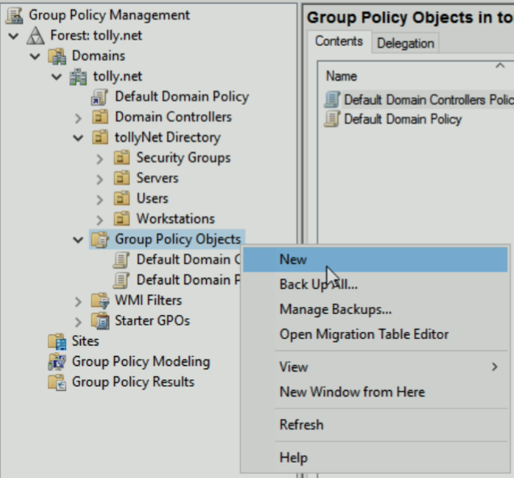
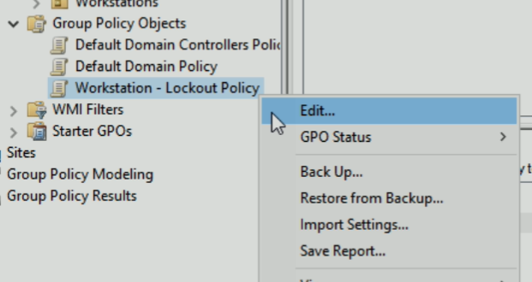
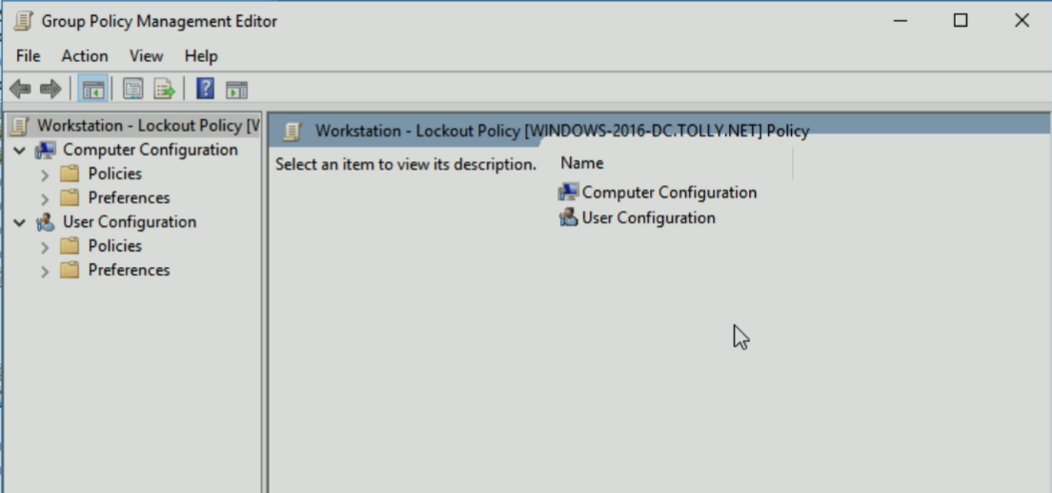
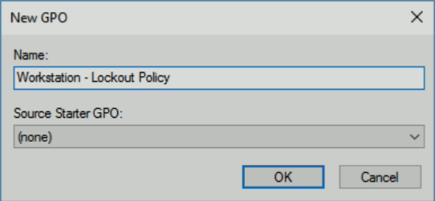
Local Admin Assignment
Local Admin Assignment

Slide 27
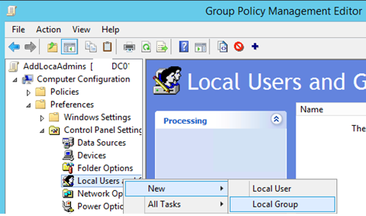
Authentication – Windows Admins
Go to the following Group Policy section
Computer Configuration –> Preferences –> Control Panel Settings –> Local Users and Groups
Right click Local Users and Groups and click New –> Local Group
Sources: http://woshub.com/add-domain-users-local-admin-group-gpo/ - https://thesysadminchannel.com/add-local-administrators-via-gpo-group-policy/

Slide 28
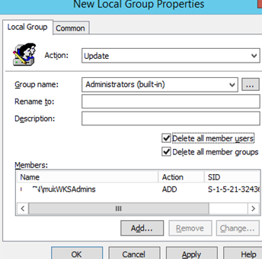
Authentication – Windows Admins
Set the Action to Update on the top
Select Administrators (Built-In) on the second row of the window
Near the bottom of the window, click Add… and add in the users and domain groups you wish to have Admin Access on the account
Deselect “Delete all member users” – otherwise you may potentially lose admin rights on the local Administrator (which is not a desirable effect)
Close out of the editor window, and assign this policy to your root domain - the tab that may look like c1234567.ads.com
On the windows 7 desktop, run gpupdate /force from the command line
Log out and then log back in with the admin login made on the domain
Sources: http://woshub.com/add-domain-users-local-admin-group-gpo/ - https://thesysadminchannel.com/add-local-administrators-via-gpo-group-policy/

Slide 29
Authentication – Windows Admins
In the event that this guide does not work, revert your VMs to before these changes occurred.
Then, follow the guide outlined here:
https://community.spiceworks.com/how_to/907-gpo-to-push-out-local-administrators-across-a-domain
Copying the clear process outlined at this link is redundant, and this resource is trustworthy

Slide 30
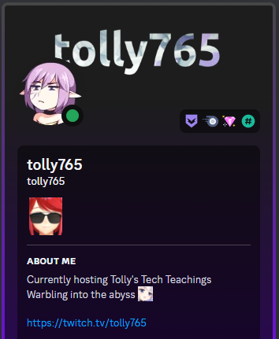
Work time?
If there are any questions, feel free to ask. More sessions are coming, so answers may be given there.

